Slide 1
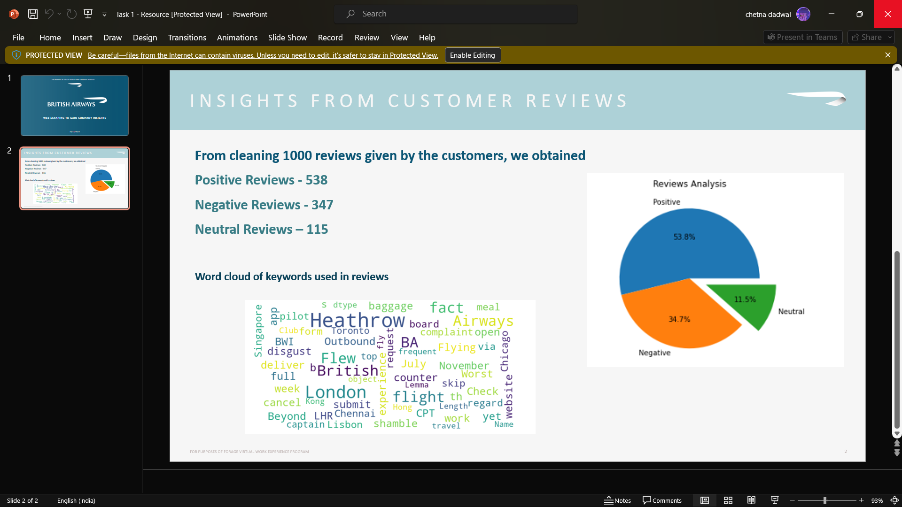
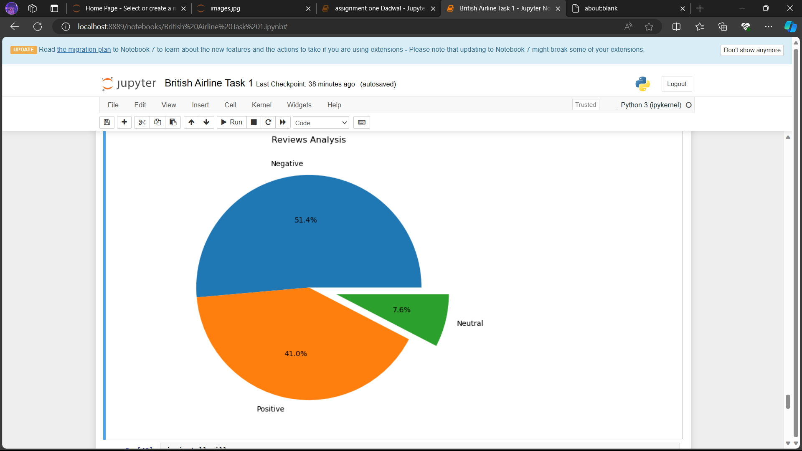
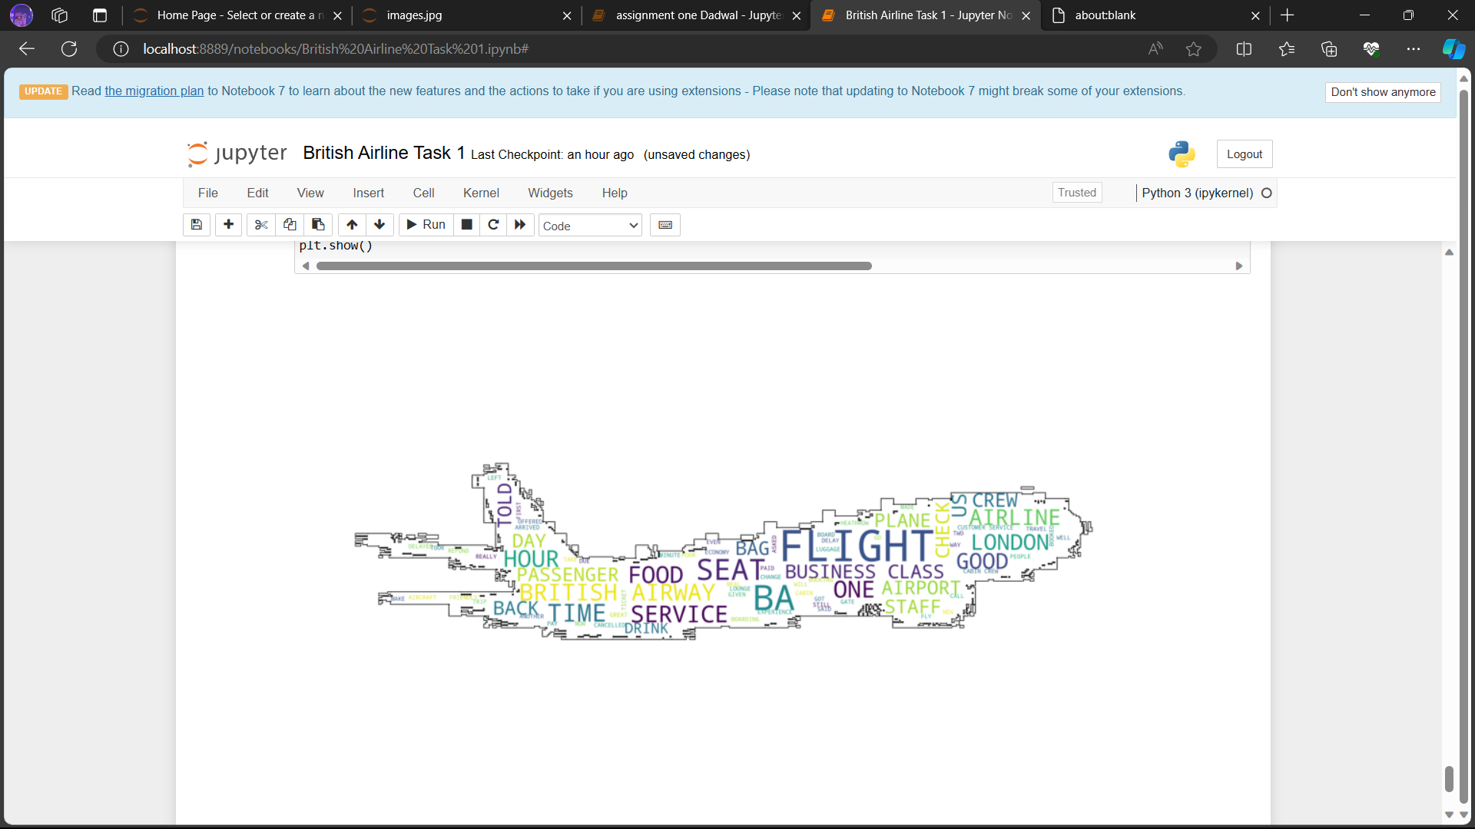
INSIGHTS OF CUSTOMER REVIEWS
From cleaning 1000 reviews given by the customers, we obtained : Positive Reviews - 538 Negative Reviews - 347 Neutral Reviews – 115
Word cloud of keywords used in reviews :

